Slide 1
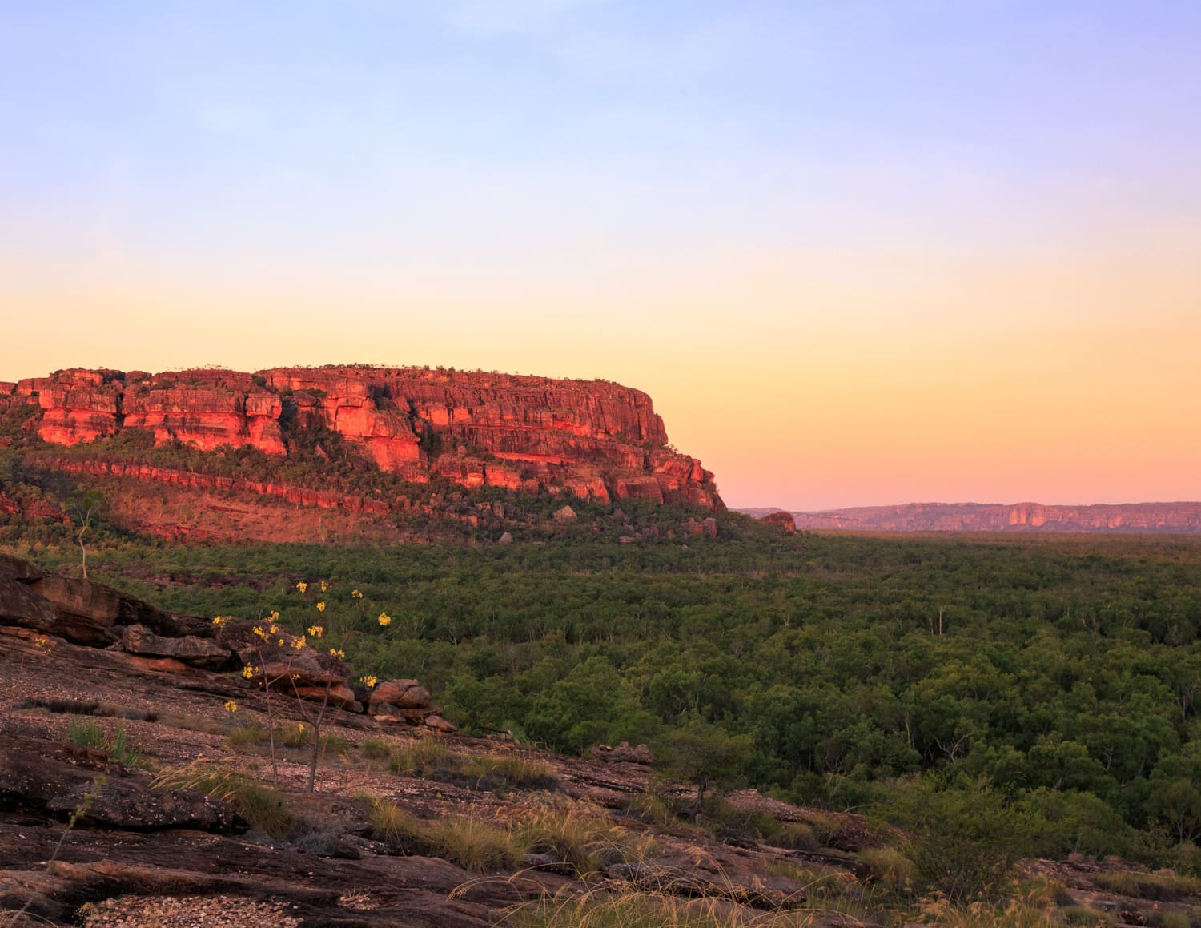
NAIDOC week
Always was, always will be
Notes:
NAIDOC Week celebrations are held across Australia each July to celebrate the history, culture and achievements of Aboriginal and Torres Strait Islander peoples. NAIDOC is celebrated not only in Indigenous communities, but by Australians from all walks of life. The week is a great opportunity to participate in a range of activities and to support your local Aboriginal and Torres Strait Islander community.

Slide 2
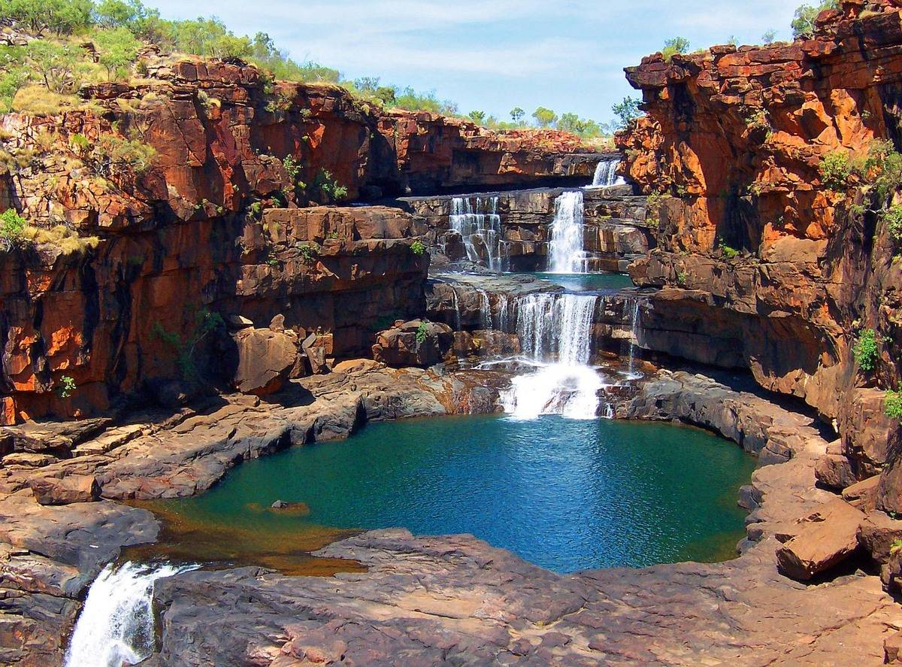
Notes:
Always Was, Always Will Be is the theme for this year and it recognises that First Nations people have occupied and cared for this continent for over 65,000 years.
Imagine God’s presence here with our First nations people prior to white settlement.

Slide 3
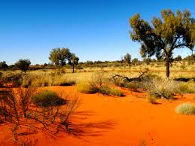
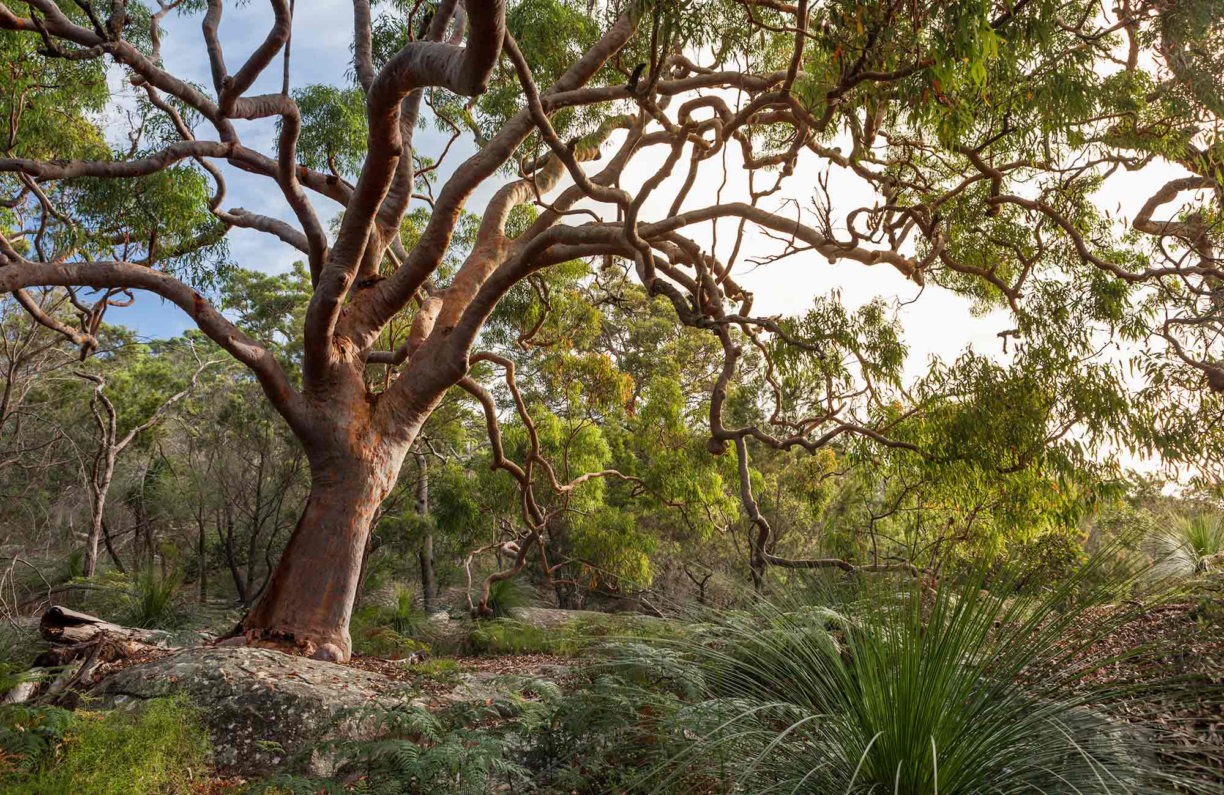
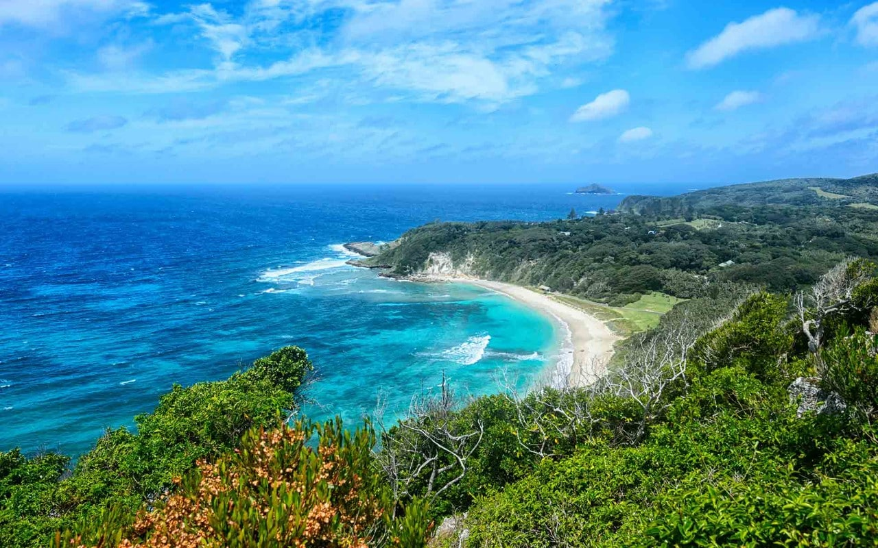
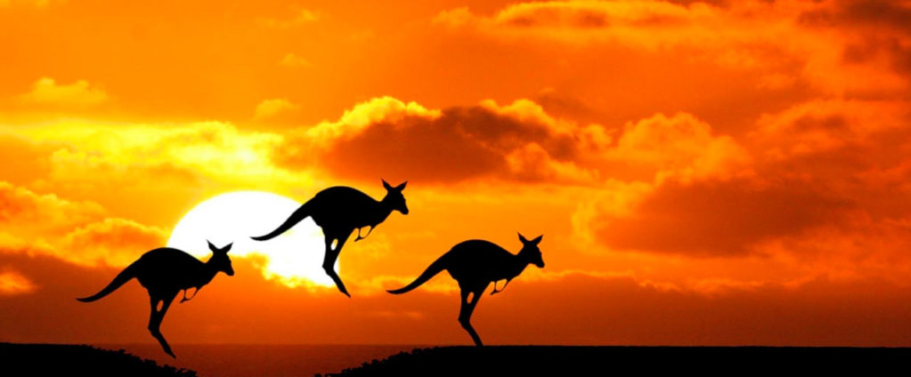

Slide 4
Mavis Malbunka was one of the first Western Arrarnta women
Notes:
GOD HAS ALWAYS BEEN HERE! by Malcolm Wilcocks
“Your mob (Lutheran Missionaries) did not bring God to our country”. Mavis Malbunka was one of the first Western Arrarnta women I got to know when I moved to Ntaria (Hermannsburg) in 2008. She was one of the leading women in the Bethlehem Lutheran congregation as well as being an authoritative voice in the community.
“God has always been here”, she continued, “He made this country, made us Arrarnta people to look after the country. He’s been looking after us all the time. What your mob did was bring us the story of Jesus. That has been good for us.”
One time I visited Mavis and her husband, Hermann at their home at Ipolera, close to Tnorala (a meteorite crater also known as Gosse’s Bluff). She explained that she and Hermann were traditional owners or custodians of the country about, 1212kms² in all, including Tnorala.
Hermann, she told me, was the custodian or caretaker of the land belonging to his family line. Like a park ranger, he could give permission for people to travel through the country. It was his role to make sure people knew where they could go to take water or food and also where not to go, such as sacred sites. His role was also to care for the plants and animals and the land itself. To help keep it healthy and abundant with food.
Mavis herself held the role of caretaker (kurturngula) of the stories that belong to the land. These stories included many important matters. Like, how various physical aspects of the country were created (such as Tnorala), how to live together, where to find food and water, what not to eat, where not to go (eg sacred sites), etc. It is her role to make sure she passes on all the stories, word perfect, to her children and grand-children so they will be able to learn from the stories, keep the stories and pass them on exactly as they had heard them.
She then went on to tell me that as Christians we all have the responsibility to be a kurturngula (caretaker) of the Bible stories. These stories have life in them. So, if we don’t learn the stories and pass them on properly (fully and truthfully) to our children and grandchildren, then not only do the stories start to die, but our children may also perish.
So, Mavis takes her role as kurturngula very seriously. Making the most of every opportunity to tell the traditional stories and Christian stories so her children won’t forget the past and will always have a future knowing the life and love of God.
Love the Lord your God with all your heart and with all your soul and with all your strength. These commandments that I give you today are to be on your hearts. Impress them on your children. Talk about them when you sit at home and when you walk along the road, when you lie down and when you get up. Deuteronomy 6:5-7 (NIV)

Slide 5
Benediction Prayer
By Francis Bodkin of the Bodkin-Andrews clan of the D’harawal Peoples
May you always see the beauty of the Earth May you always taste the sweetest fruit May you always hear the laughter of the People May you always feel the warmth of the Flame May you always smell the perfume of the flowers May your dreams always be happy ones May your friends always be with you when you have need May your stomach always be full May you never feel hurt

