Slide 1

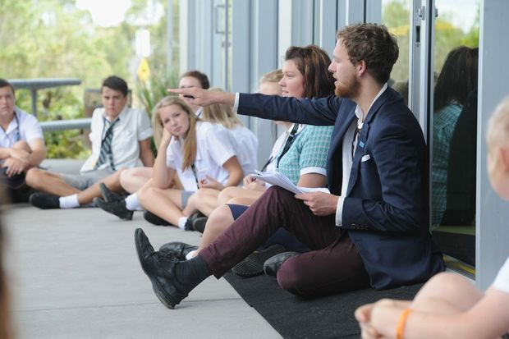
Christian Studies
Critical thinking, freedom and engagement
Dominique Jacqueline
Anne Dohnt
Notes:
The following workshop has been developed to provide an opportunity for CS leaders and teachers to read and reflect on the Christian Studies in years 11 and 12 research.
While the research provides some real challenges for the teaching of Christian Studies it also provides some real insights into ways that Christian Studies can be developed to meet the needs of students.
Teaching Christian Studies in the senior years requires providing students with the opportunity for critical thinking, freedom and engagement.

Slide 2

Notes:
Provide time to read through the data if it has not been pre-reading.
Discuss:
How does the research connect to your knowledge of and experience with Christian Studies?
How does it extend your thinking?
What challenges does it present for CS leaders, CS teachers, students?
Compile questions and in the subsequent slides and discussion look for opportunity to respond to the questions.

Slide 3
context purpose pedagogy curriculum
What knowledge, capabilities, dispositions are needed to engage students in the spiritual and to nurture the spiritual lives of students?
How does Christian Studies (CS) provide for student voice and choice?
How does CS develop an openness to issues of faith and belief?
What is our impact in CS?
What does it mean to be a ‘good’ learner in CS?/What is the success criteria for CS?
How does CS support students to critique culture? – an apologetics of culture
Notes:
The research suggests that these questions are important for CS leaders, teachers and students. These are challenging questions and each leads to reflection on current practice, review and action.
Which of these questions is of greatest priority in your school’s Christian Studies program or in your Christian Studies classroom?

Slide 4
Context
> for teachers
> for students
‘It’s not her fault that she can’t deal with the questions that we have. She just doesn’t have the knowledge or experience to explore these questions with us.’
[student comment]
Apathy is the greatest challenge. This is mandated when they get a lot more choice in other subjects.
[teacher comment]
Notes:
These comments were taken from the report.
Use paper to create a mind map of the context at your school.
Teacher and student backgrounds
Teacher preparedness in relation to approaches to the teaching of religious education, areas of specialisation, eg science and faith, ethics,
Make a list of the contextual features that support the teaching of Christian Studies and those that provide challenges for the teaching of Christian Studies. Sort the helpful and challenging features into those that can be changed and those that cannot.
Discuss:
How can we work with the helpful contextual features to further enhance the learning in Christian Studies?
How can we work to improve the challenging contextual features? (eg What can you do to respond to the student’s comment about the teacher not having enough information to assist the students inquire into issues of faith and spirituality?)
Prioritise what needs to be done in an action plan.

Slide 5
purpose
What are our learning intentions?
Christian Studies is a discipline of study. To create meaning you need a framework and Christian Studies helps students make meaning. …. It is part of our curriculum in terms of the development of the capacities of students. [principal’s comment]
‘ It does not force Christian views upon anyone; at my school Christian Studies is about learning different religious viewpoints; promoting respect for all cultures.’
[student comment]
Notes:
Review the school policy, website and prospectus to explore what is said about the purpose of Christian Studies.
Discuss:
What does the CSCF say about the purpose of Christian Studies? ( p5,6 of the CSCF)
What is the purpose of Christian Studies at this school?
How do we communicate this to students, staff, families?

Slide 6

Students are mentored to:
become articulate, empathic and discerning members of their communities
listen to and identify the issues underlying discussion
enter into open, respectful dialogue with people whose religious, philosophical, ethical views are different
present an informed, well-defended personal position
CSCF Rationale p6
Notes:
Reflect on what happens in your Christian Studies classroom.
Use unit plans, work samples, photos to identify where students have experienced the activities listed in the Rationale.
Where are the rich experiences and where are the areas for improvement?

Slide 7
pedagogy
‘being able to research your own interest in theology’
[student comment]
‘to learn the religion interactively with a teacher and peers – not always reading from a textbook or watching a video’
[student comment]
‘I love it when it makes my brain hurt’
[student comment]
Notes:
Read the pedagogy of Christian Studies (p7,8 CSCF)
Review your unit plan in light of the pedagogy described in the CSCF. Work with a partner to innovate on your unit plan.
Discuss: What would a ‘student designed’ Christian Studies unit and lesson look like?
Plan a Christian Studies lesson where students could be engaged in developing a ‘student designed’ Christian Studies unit.

Slide 8
pedagogy
It’s not her fault that she can’t deal with the questions that we have. She just doesn’t have the knowledge or experience to explore these questions with us.’ [student comment]
Are you a life long learner?
How do you inquire into issues of faith and belief?
Notes:
Discuss:
How does Christianity help you make sense of your identity, life experiences and the world?
How do we develop an awareness both explicitly and implicitly, that Christian belief is a life journey of questions, doubt and assurance and certainty?
Where have students had the opportunity to pose their questions in the Christian Studies unit?
Review your unit plans and students work samples to identity examples of what this looks like at your school, in your classroom.

Slide 9
curriculum
How do you make decisions about scope and sequence, the deep understanding, about what to include and what to leave out?
‘We want stuff that is respectful of our intellect.’
[student comment]
Notes:
Review your Christian Studies scope and sequence to reflect on what is working and what needs to be changed.
Discuss:
How do the units nurture deep understandings?
What do we need to change, add, and leave out?

Slide 10
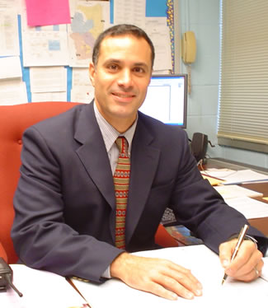
‘Christian Studies requires the most highly qualified teachers as they need to be able to cope with challenging theological questions.’
[principal comment]
Notes:
Discuss:
How do we choose Christian Studies teachers at our school?
How do we ensure that Christian Studies teachers have the knowledge and skills to teach Christian Studies well?
Reflect upon what this means for:
me as a CS teacher?
for the CS faculty?
for school leadership?
Make a plan for the initial and ongoing support of Christian Studies teachers.

Slide 11
Christian Studies
Reflect on the issues and ideas generated.
What are your top three priorities for Christian Studies at your school?
Share with colleagues and develop an action plan for the ongoing improvement of Christian Studies at your school.

